Slide 1
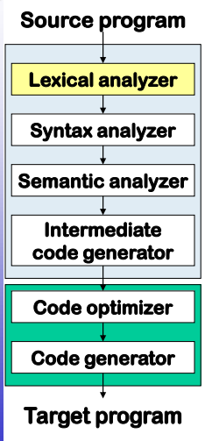
Compiler
Phases of Compiler:

